Slide 1
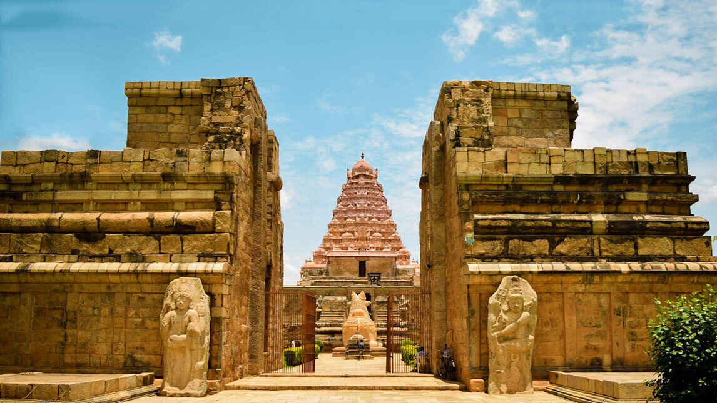
WELCOME TO ARUMPORUL
LET’S TRAVEL THROUGH THE ANCIENT TAMILNADU

Slide 2
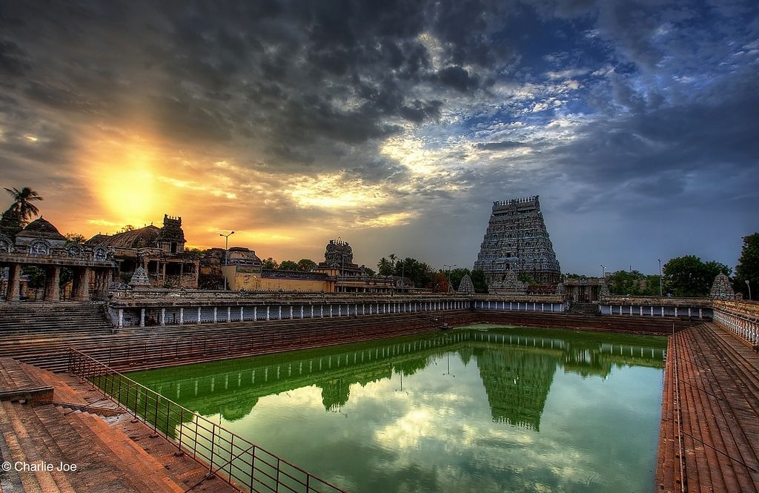









TEMPLE PRESERVATION AWARENESS
At the core of our mission lies the promotion of temple preservation awareness. Through our platform, we aim to educate and inspire individuals about the importance of safeguarding Tamil Nadu's endangered temples, ensuring their cultural significance and historical value are appreciated and preserved for future generations to cherish.

Slide 3
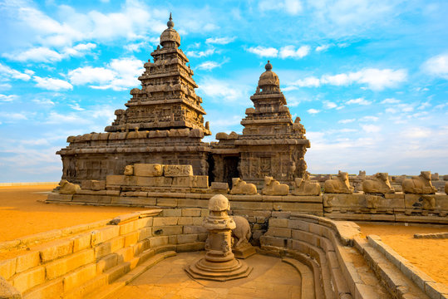
Active Community Engagement
Our platform fosters vibrant community interaction, enabling users to connect, share experiences, and collaborate on initiatives to preserve Tamil Nadu's endangered temples. Through integrated Gmail account creation, users can easily join and contribute to these efforts, fostering a collective sense of responsibility towards our cultural heritage.

Slide 4
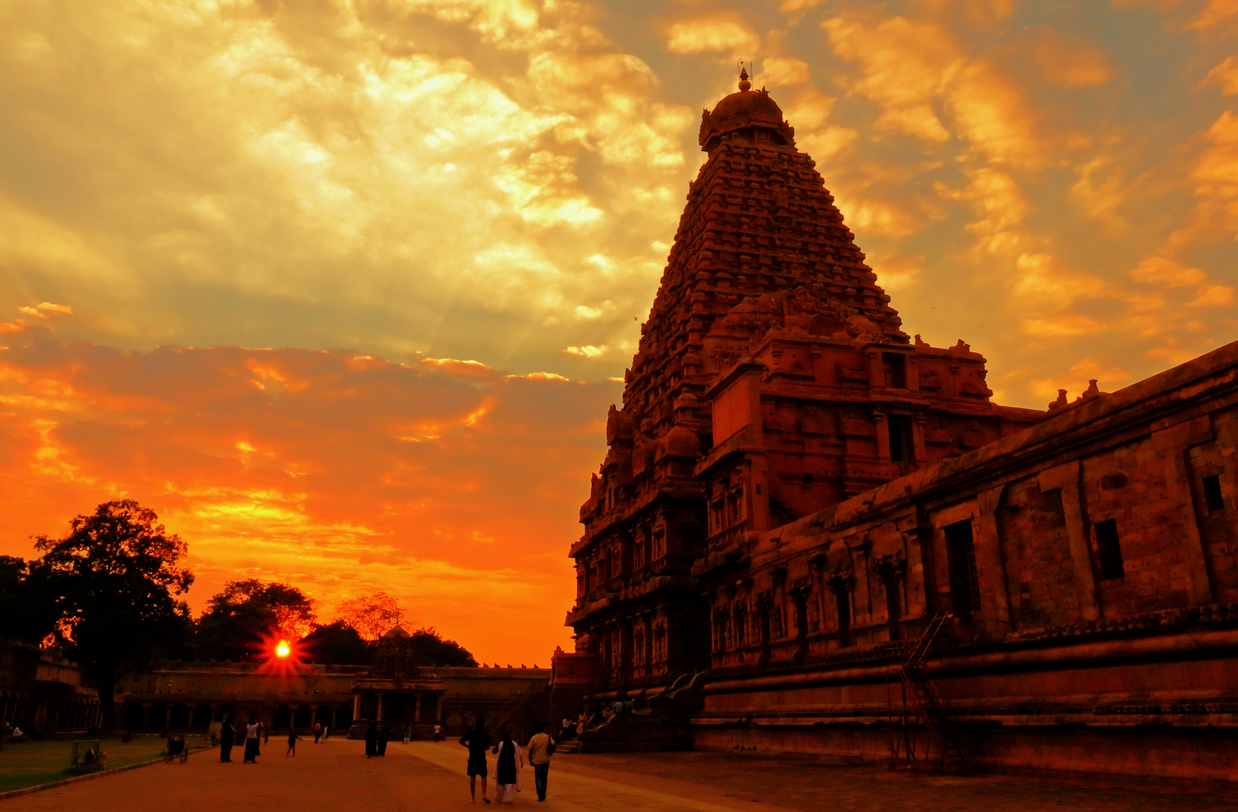
Multilingual Audio Guide
Our website offers a unique feature – a multilingual audio guide. Visitors can explore these temples while listening to narrations in their preferred language, enhancing their understanding and appreciation of the rich history behind each site.

Slide 5
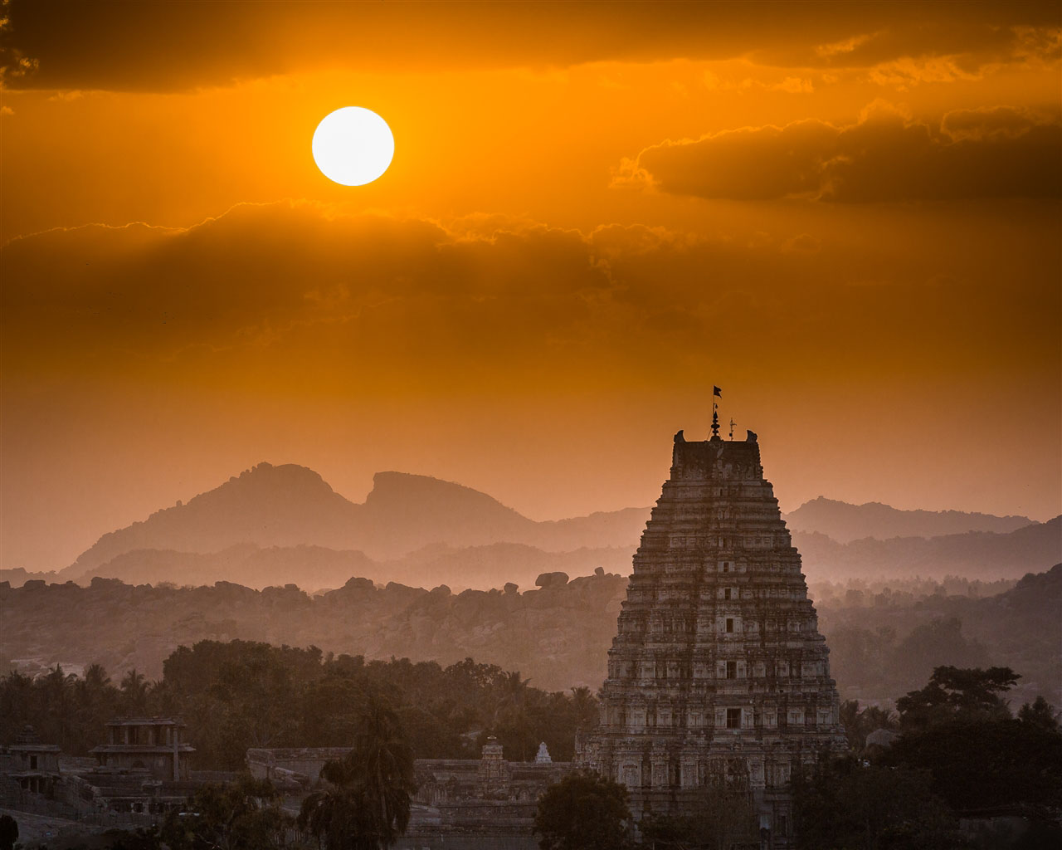
Interactive 360-degree Views
Experience the beauty of Tamil Nadu's temples like never before with our interactive 360-degree views. Step into these sacred spaces virtually and immerse yourself in stunning visuals that capture every intricate detail of these architectural wonders.

Slide 6
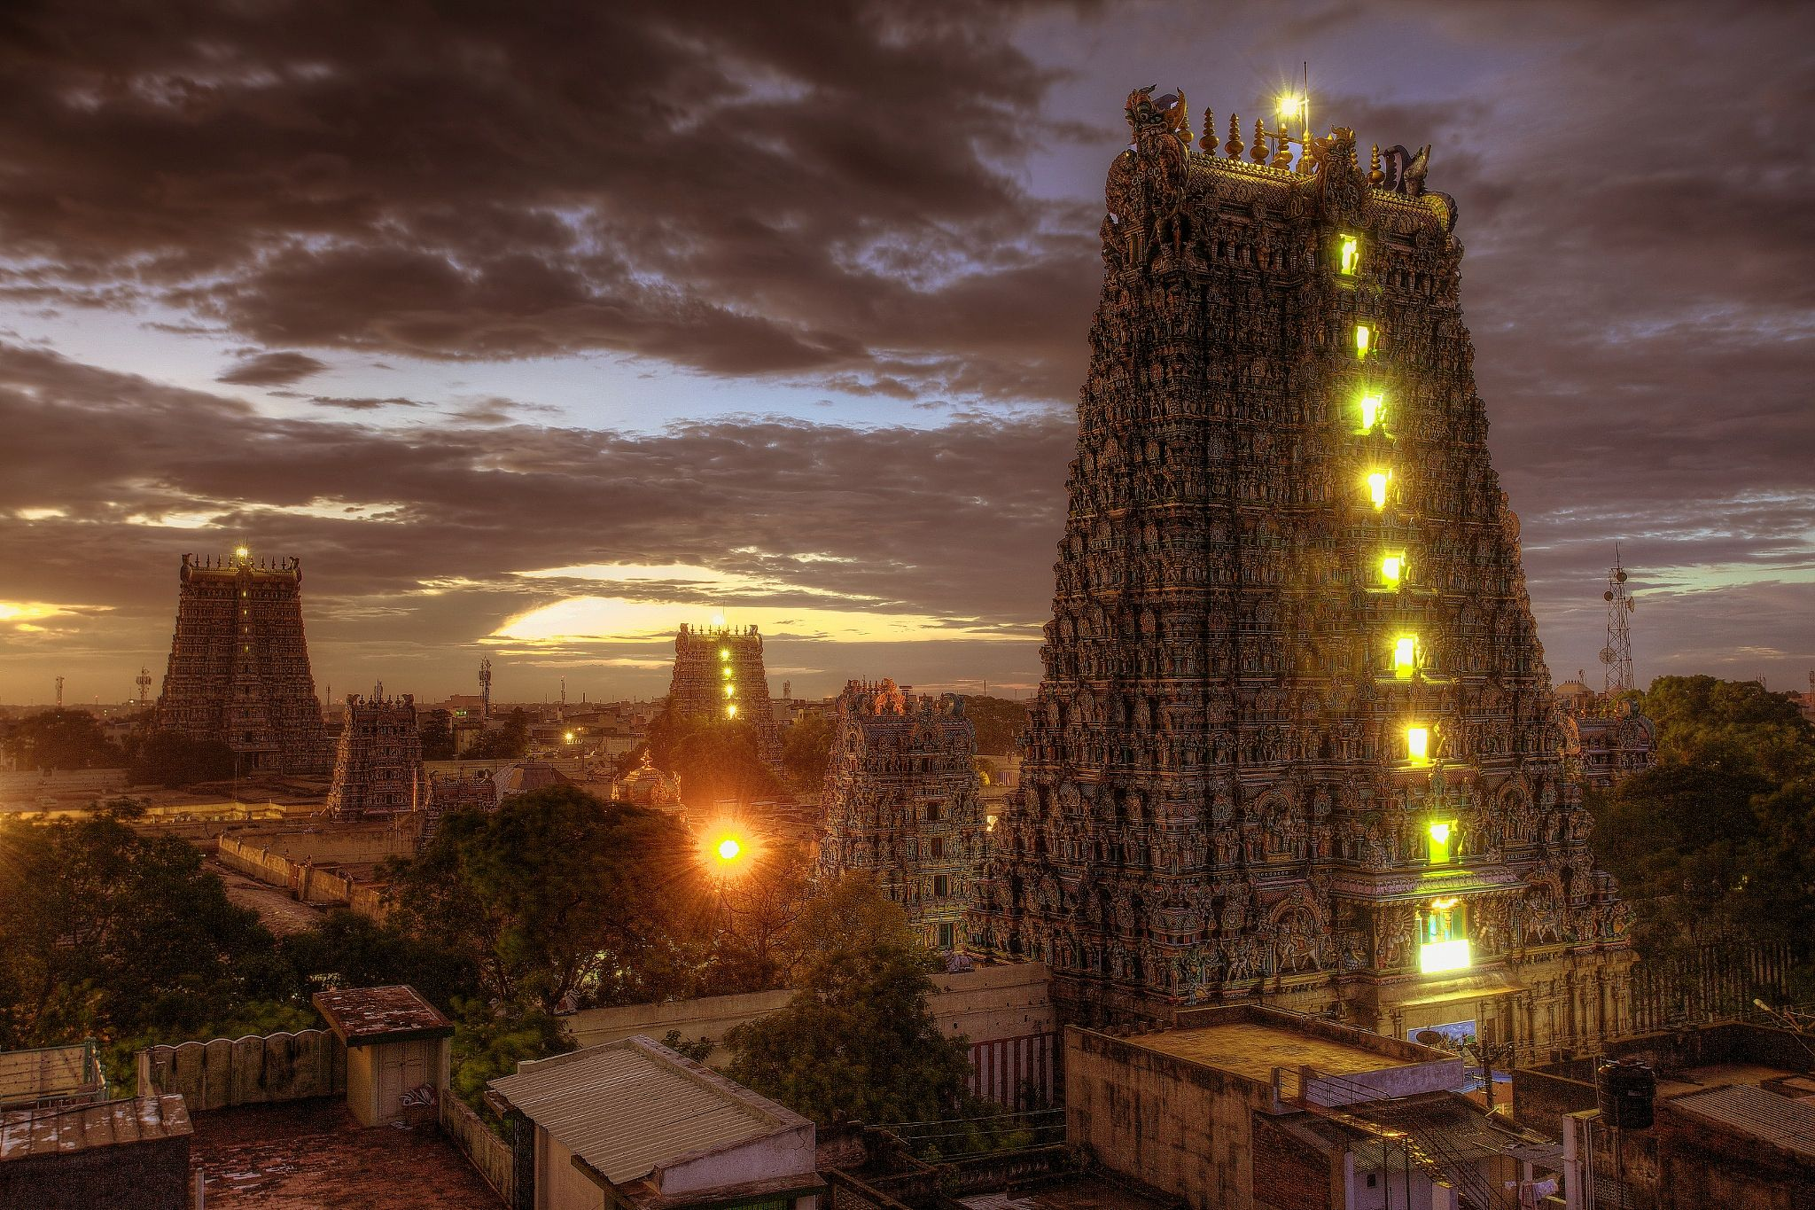
Localized Heritage Preservation Efforts
We prioritize localized efforts to preserve Tamil Nadu's heritage by collaborating with local communities, authorities, and organizations. Together, we work towards safeguarding these cultural treasures for future generations to cherish and admire.

Slide 7
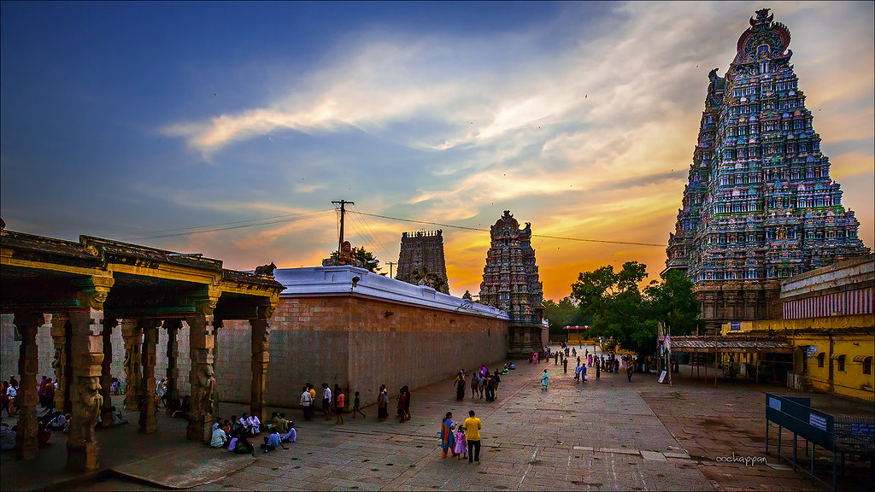
Networking through Community Pages
Our platform fosters connections through community pages where users can share their temple experiences, exchange insights, and collaborate on preservation initiatives. It's a space where like-minded individuals come together to make a difference.

Slide 8

Authentic Temple Experiences Shared
Users are encouraged to share their authentic temple experiences, whether it's a newfound discovery or a cherished memory from generations past. By sharing these stories, we celebrate the enduring legacy of Tamil Nadu's temples.

Slide 9
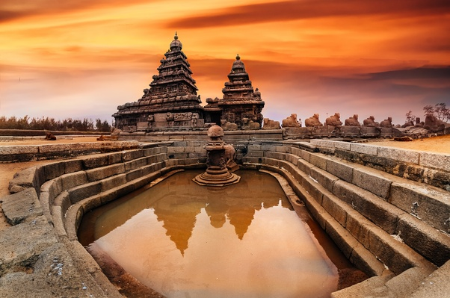
Diverse Cultural Heritage Advocacy
Our advocacy extends beyond individual temples to embrace the diverse cultural heritage of Tamil Nadu. Through education, outreach, and advocacy campaigns, we strive to raise awareness about the importance of preserving our shared heritage.

Slide 10
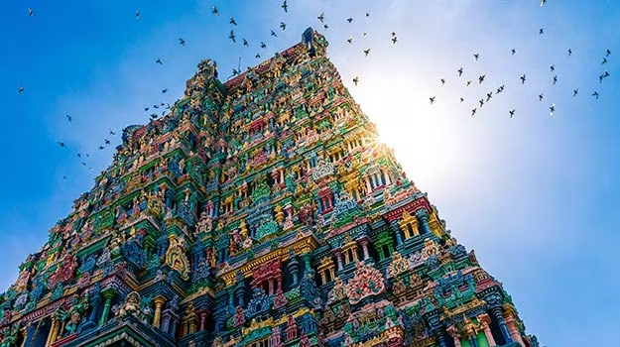
User-generated Content Amplification
User-generated content is at the heart of our platform. By amplifying user contributions, we amplify the voices of those passionate about preserving Tamil Nadu's heritage, ensuring their stories reach a wider audience for maximum impact.

Slide 11

ARCHITECTURE DIAGRAM

Slide 12



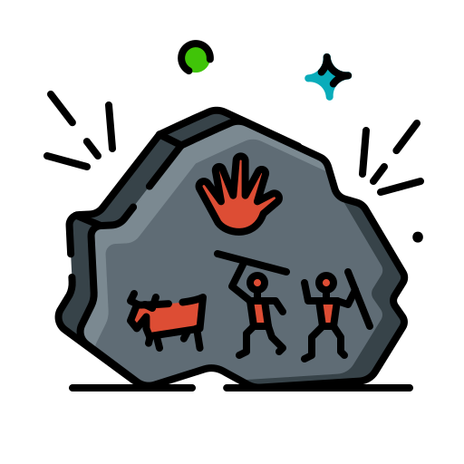
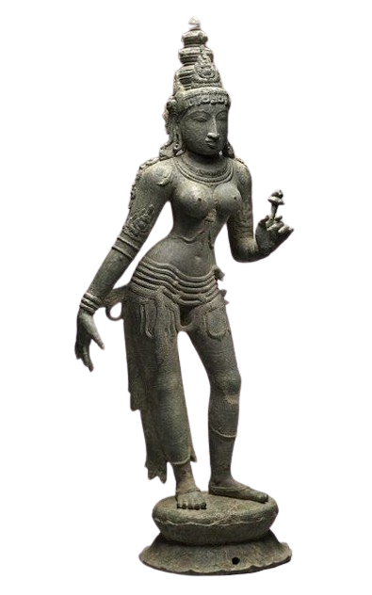










MULTILINGUAL SUPPORT
360 DEGREE SUPPORT
AUGMENTED REALITY SUPPORT
AI CHATBOT SUPPORT
TANGIBLE HERITAGES
FEATURES
ARUMPORUL WEBSITE
FIELD RECORDING
DATABASE
EVALUATION&
ENRICHMENT
RESEARCHERS
DOCUMENTATION
USERS

Slide 13
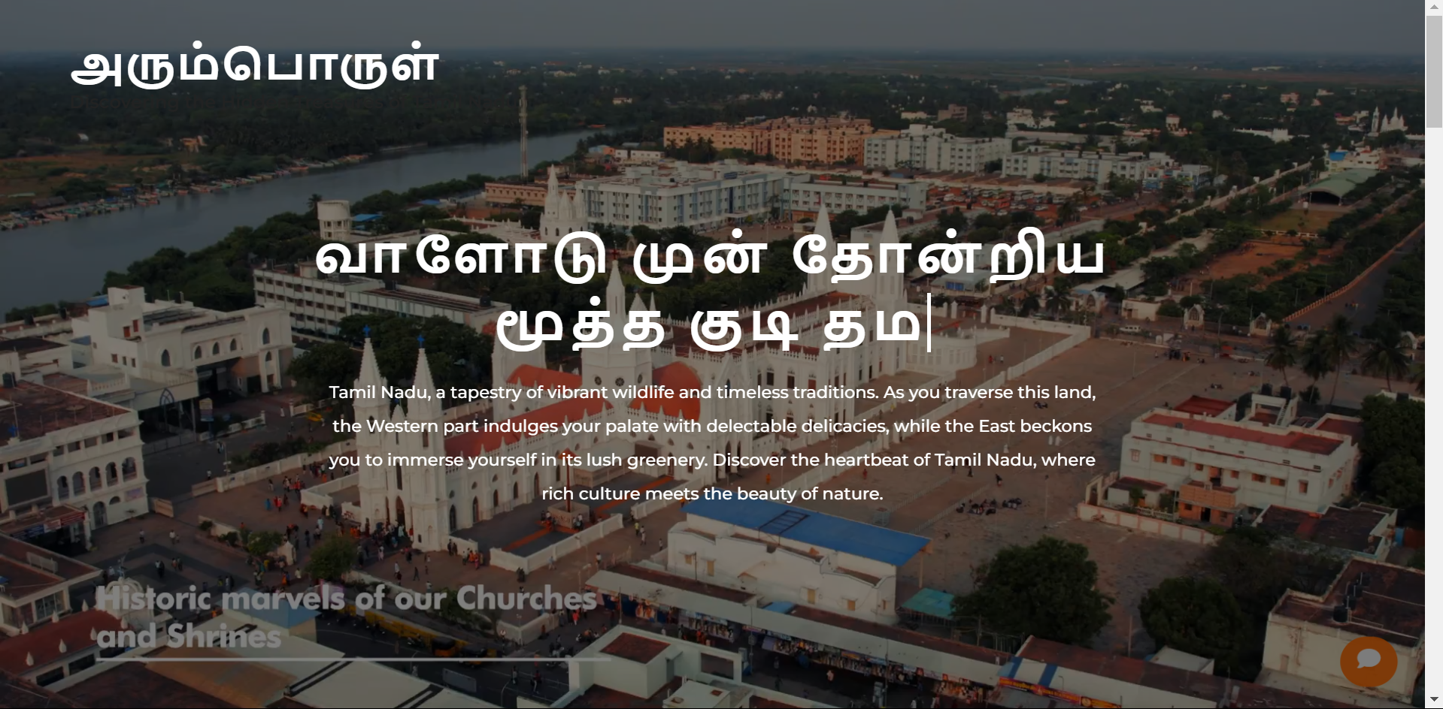
output
HOMEPAGE

Slide 14
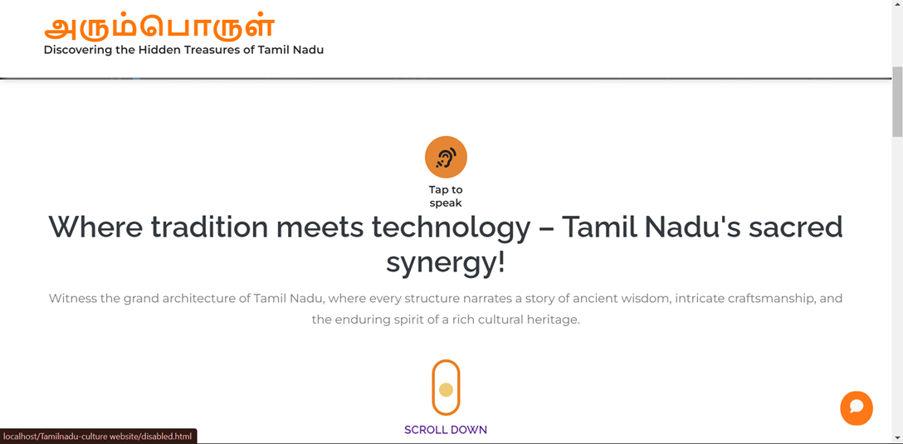
MULTILINGUAL AUDIO SUPPORT

Slide 15
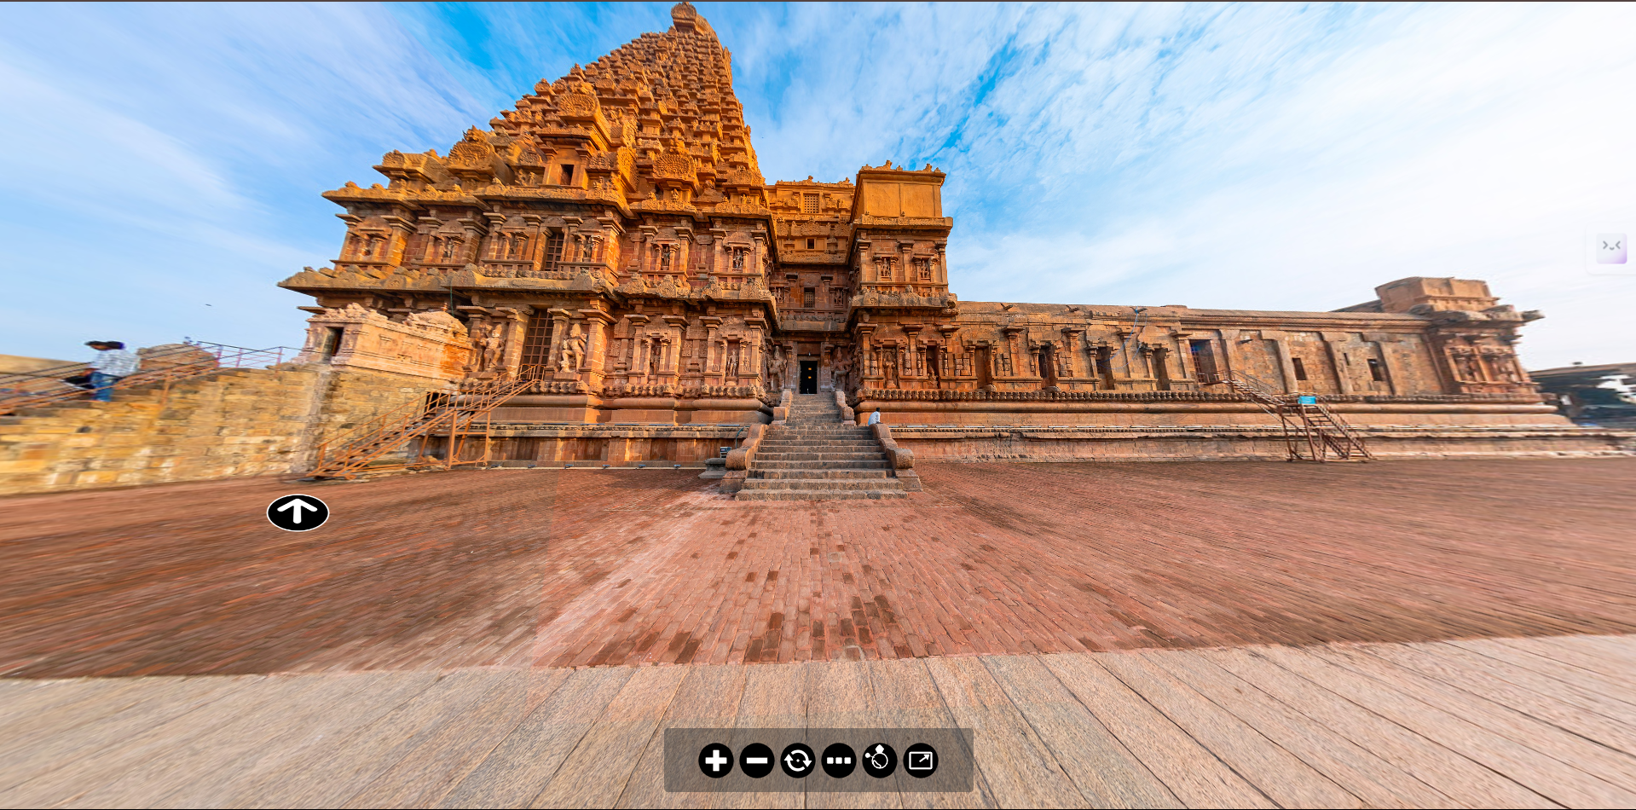
360 degree view support

Slide 16
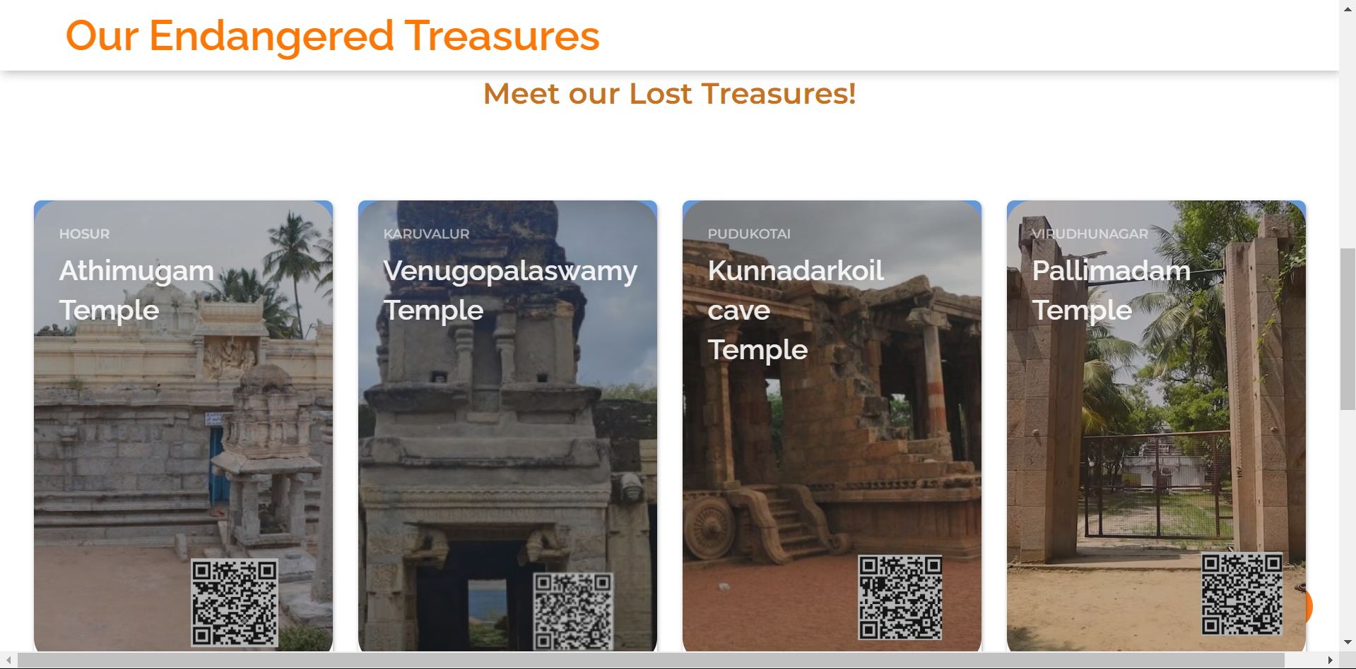
Endangered Temples page

Slide 17
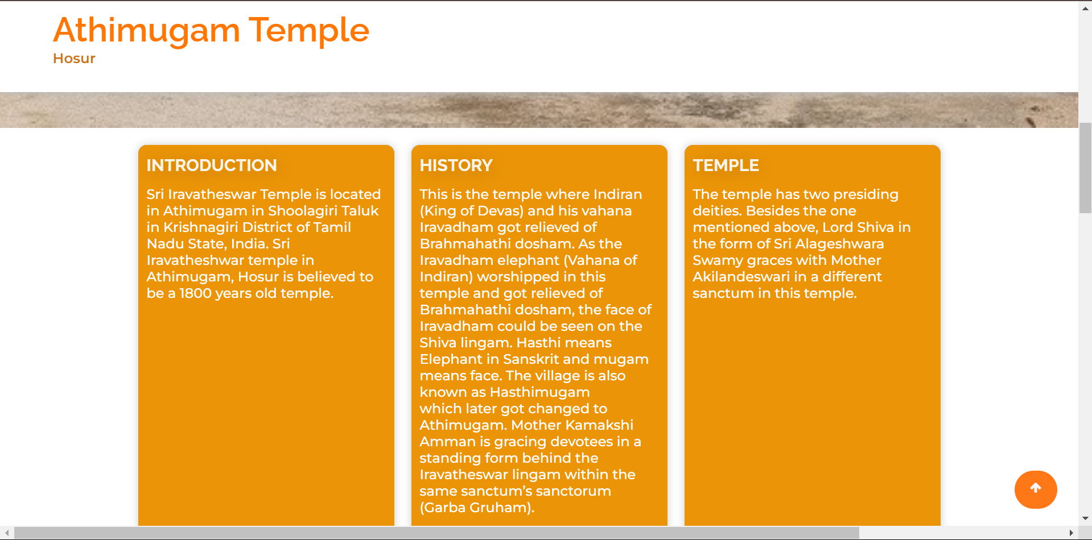
Temple History page

Slide 18
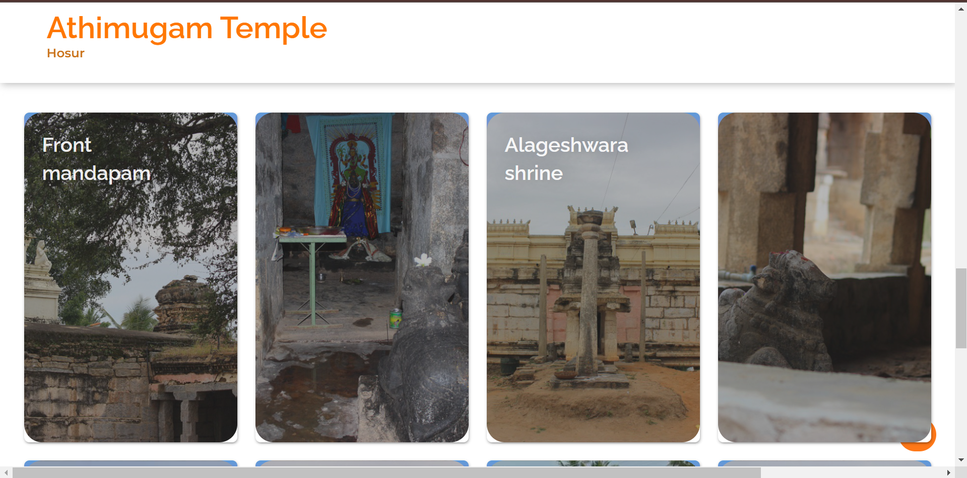
Temple gallery page

Slide 19
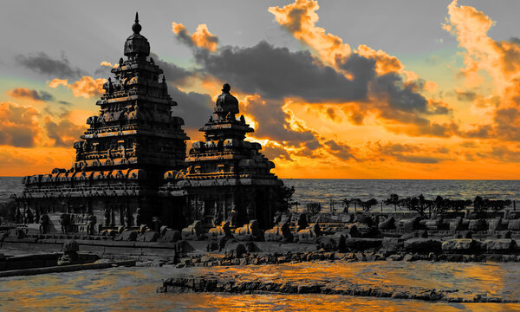

HAVE
ANY
QUESTIONS?

Slide 20
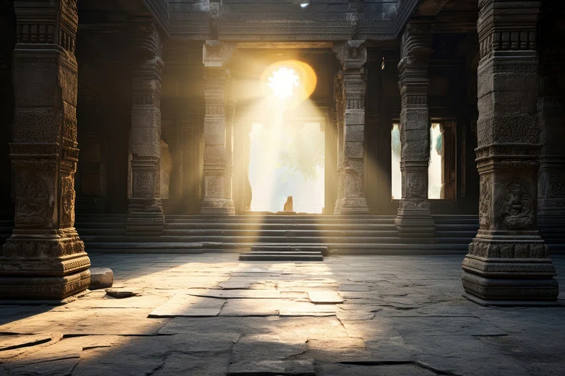
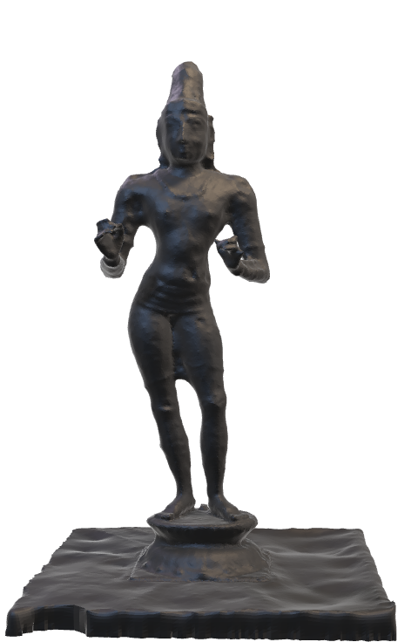
THANK YOU

